Slide 1
Utility in Decision Networks

Slide 2
Decision theory, in its simplest form, deals with choosing among actions based on the desirability of their immediate outcomes
A decision network (also known as an influence diagram) extends Bayesian networks by incorporating actions and utilities.
Utility function, U(s), assigns a single number to express the desirability of a state.
The expected utility of an action given the evidence, EU (a|e), is just the average utility value of the outcomes, weighted by the probability that the outcome occurs:
The principle of maximum expected utility (MEU) says that a rational agent should choose the action that maximizes the agent’s expected utility.

Slide 3
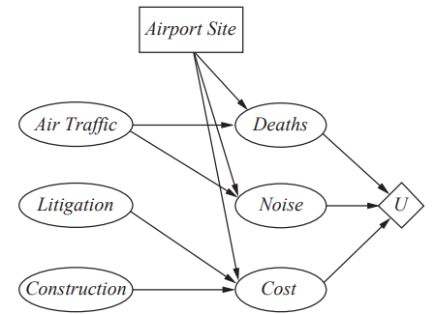
A sample decision network
Action node
Utility node
Chance nodes:
Air Traffic, Litigation, Construction Deaths, Noise , Cast

Slide 4
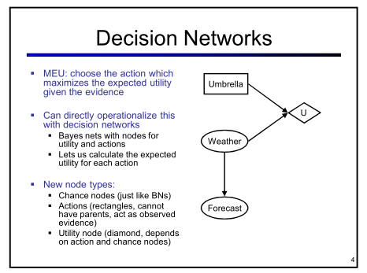

Slide 5
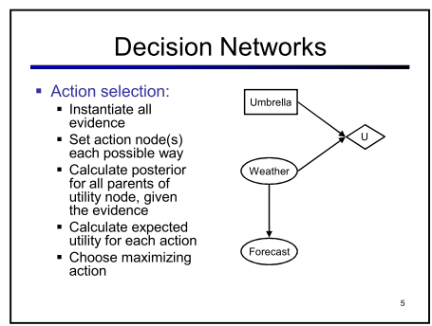

Slide 6
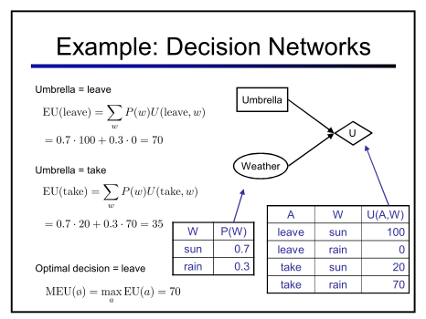

Slide 7
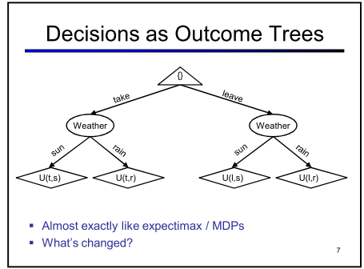

Slide 8
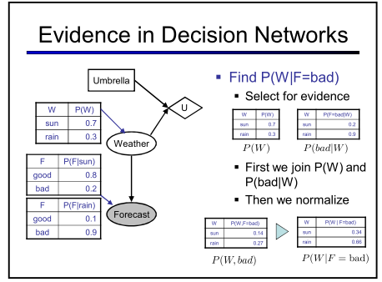

Slide 9
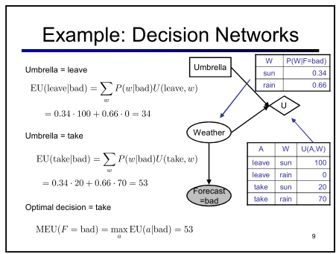

Slide 10
